Slide 1
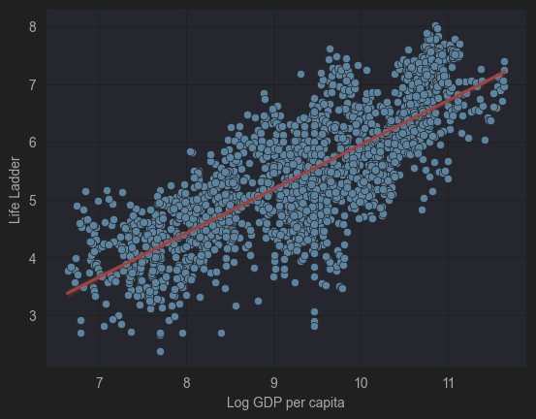
Data Management Project
Student Individual Assignment
What is the relationship between income (Log GDP) and happiness (Life Ladder)?
Student name: Fayyaz Hussain Shah
Student ID: 946912
Student e-mail address: f.shah5@campus.unimib.it

Slide 2
Introduction
Problem Statement
- To Perform EDA on the relationship of Logged GDP per capita of the country and it’s Happiness score – Life Ladder.
Project Goals
- Collect recent data from an API source (2021–2024)
- Integrate both datasets into a single standardized dataset
- Assess and improve data quality
- Store the final dataset in SQL and NoSQL databases
- Perform Exploratory Data Analysis (EDA)
- Identify trends in Life Ladder and Log GDP per capita
Research Questions
- What is the relationship between income (Log GDP) and happiness (Life Ladder)?
- Top Performers of Life Ladder and GDP
- Evolution of GDP and Life Ladder Globally
- Evolution of Italy’s Life Ladder and GDP throughout.

Slide 3
Technical Brief
The Data source 1 (Kaggle Dataset) contains the following data for year 2005-20,
Country Name
Year
Log (GDP per capita)
Happiness Score
The Data source 2 (World Bank Open API Endpoint) contains the following data for year 2001-24,
Country Name
Year
GDP per capita
Happiness Score
Issues that will be handled in Data Transformation :
Missing values of GDP in Source 1
Missing some data of entire year for some countries in Source 1
The API returns the data in JSON format in Source 2
GDP is not logged in Source 2
Column Names and types mismatch
Note: More Columns in both sources, but we will use and save only above mentioned in our final DB
Final Transformed and Merged Data will be in SQL DB

Slide 4
About GDP and Happiness Score in Data
What is GDP and how it is calculated ?
Total monetary value of all final goods and services produced within a country in a period (usually a year).
GDP=C+I+G+(X−M)
C– Consumption - Household spending on goods/services (food, rent, transport)
I – Investment - Business spending on machinery, buildings, inventory; residential construction
G – Government Spending - Public services, infrastructure, salaries (excluding transfers)
X – M (Net Exports) - Exports minus imports; measures international trade
GDP per capita: GDP/Population
Log GDP per Capita : ln(GDP/Population)
What is Life Ladder Score and how it is calculated ?
Subjective well-being measure; people rate their life from 0 (worst) to 10 (best).
Survey method: “Imagine a ladder from 0–10. On which step do you feel you stand today?”
Country score: Average of all survey responses.
Other Factors affecting Life Ladder:
Social support
Healthy life expectancy
Freedom to make life choices
Generosity
Perceptions of corruption

Slide 5
Insights from the Data
The Raw data was missing the values for many countries for a few years, which would have made the graphs represent in correct visuals hence the missing values were added via statistical modelling in Data Transformation phase.
The Scatter Plot wit Regression slope line clearly defines the relationship between GDP and Happiness of a country
After Analyzing the sorted graph, the top performers of GDP surfaced and it's not a surprise for them to be also the toppers of happiness score
The overall trajectile of Evolution of GDP, as a planet, is Linear even though we have an influencing pandemic in between the timeline.
Individual countries’ trajectile shows a Linear GDP through time however various categories to be formed where the Happiness ladder fluctuated or remain linear with GDP.
The Final Scatterplot Graph shows us the domain in which both players of all the countries have stayed in during all this time – The peak and bottom of all – an enclosed circle with no outliers but divisions

Slide 6
Relationship of the GDP of a country and the happiness of its people
Strength of relationship
The closeness of the points to the regression line shows the strength and the opposite reflects weakness.
Direction of relationship
The upward slope shows partial direct proportionality – partial because of the not so strong relationship
Exceptions – Outliers
Countries above the red line: happier than expected for their GDP
Countries below the line : less happy than expected for their GDP
Summary
Scatter + regression line shows how Life Ladder changes with Log GDP per capita.
Each point represents a country-year, and the red line shows the average trend.
Points close to the line mean strong relationship; outliers show exceptions.

Slide 7
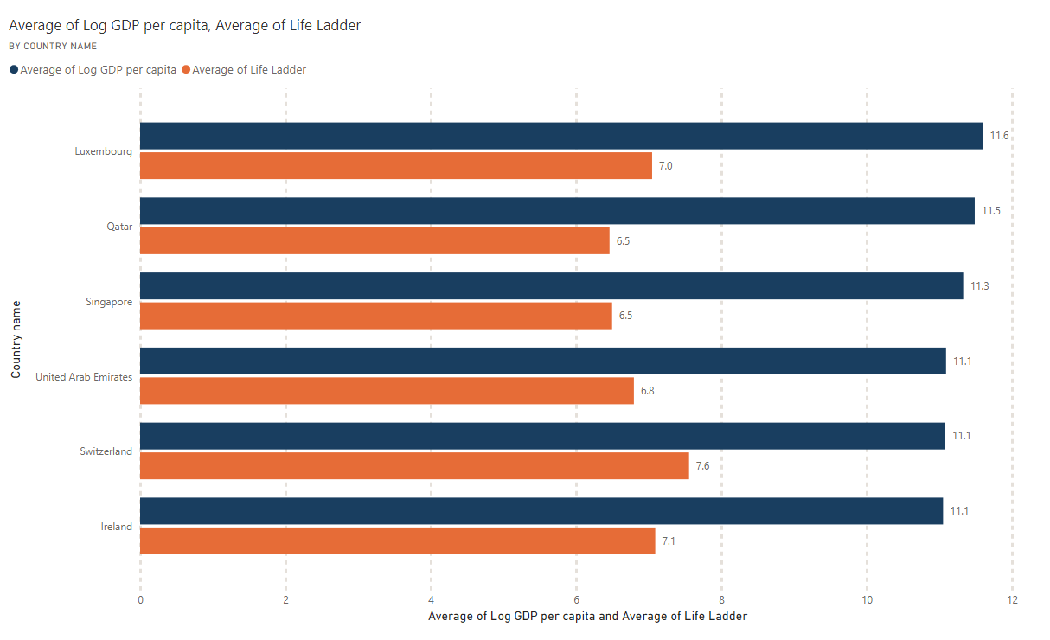
Top Performers of GDP and Life Ladder
This visual studies the top performing countries through out the years and see if they are commonly performing for both or not.
The top performing countries do show a strong positive connection between the GDP and Happiness score however within them there are many contradictory outliers
There are various Middle East countries who couldn’t achieve the same happiness score even after matching the GDP with the top runners
This concludes that though Happiness score has strong ties with the GDP but it is not the only contributing factor
Visual 2
NOTE : The Graph on top is incomplete. Please click on the link above to view the complete scrollable graph.

Slide 8
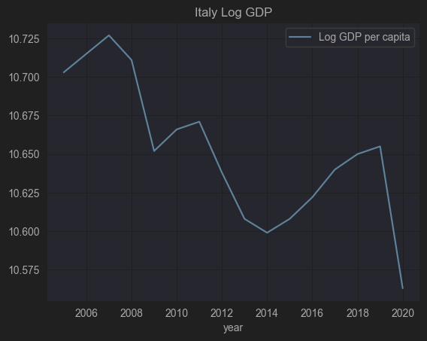
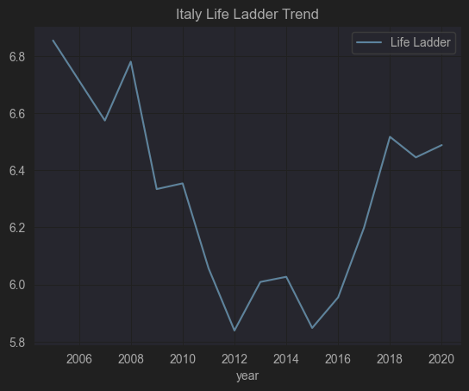
Evolution of Life Ladder and GDP in Italy thought out the time

Slide 9
LICENCE
Slides are shared with the following license:
What is the relationship between income (Log GDP) and happiness (Life Ladder)?
by Fayyaz Hussain Shah, is licensed under a CC-BY-SA

